Slide 1
Preparing for Ministry
The path toward ordination
as a
Teaching Elder

Slide 3
Hearing a Call
Esther
Jeremiah
Matthew

Slide 4
Ordination Requirements
Discernment
Academic
Requirements
Ordination
Standards

Slide 5
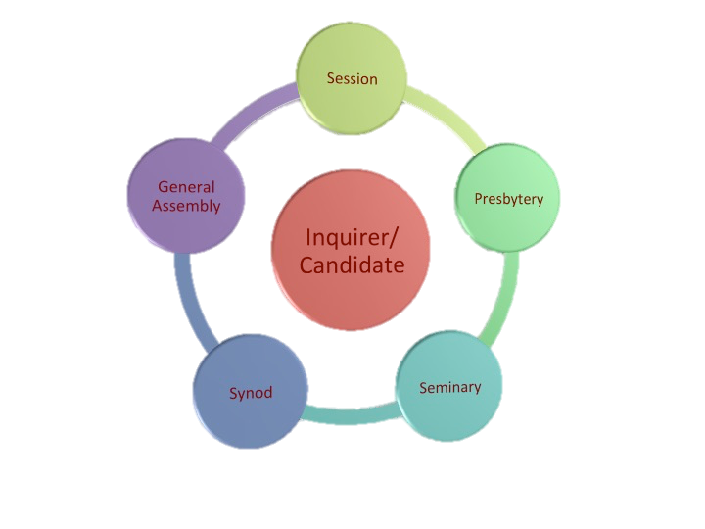
“I will not leave you orphaned”
John 14:18
Community of Care

Slide 6
Stages of Preparation
Hearing a call to ministry
Inquiry
Candidacy
CPE (Clinical Pastoral Education)
May be done during Inquiry or Candidacy
Final Assessment
Accepting a call (i.e. job offer)
Examination
Ordination

Slide 7
Inquiry
Hearing a call
Conversations
Pastor
Friends, mentors
Request for session endorsement
Comes under care of session
Session assigns liaison
Application to presbytery CPM
Interview for inquirer status
CPM assigns liaison
Duration: one year

Slide 8
Candidacy
Inquirer completes application forms
Meets with session for endorsement
Files application with presbytery office
Includes faith statement, faith journey, transcripts, field education/internship evaluations
Meets with CPM for candidacy interview
CPM reports outcome to session & presbytery
Presbytery reports outcome to PCUSA office, Louisville
Presbytery examines Candidate
Candidate meets with CPM liaison for annual consultation

Slide 9
Clinical Pastoral Education
Our presbytery requires one unit of CPE
Takes place in a hospital context (usually)
Emotionally challenging and enriching
Provides an experiential context for deeper emotional and spiritual maturity:
“A dose of real life”

Slide 10
Final Assessment
After 1 year of candidacy
5 ordination exams
Completion of written requirements
CPM interview
Certification: Ready to receive a call

Slide 11
Next Steps
PIF
Call to a specific ministry
Ordination
Celebration!
Removal from session & presbytery rolls

Slide 12
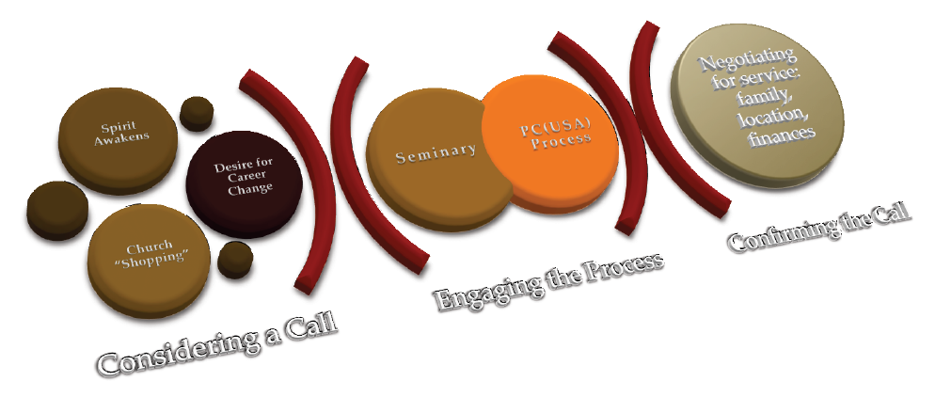
Variations can occur
Adjusting the means of assessment:
Focus is on outcomes

Slide 13
Session and Presbytery
Caring for the candidate
Support
Guidance
Inquirer/
Candidate
Session
CPM
Encouragement
Assessment
Mentoring

Slide 14
Session’s Role
Develop awareness of Christian vocation in the congregation
Educate the congregation
Encourage those in whom you see gifts for ministry

Slide 15
Session’s Role: Inquiry
Contact CPM for session orientation
Interview applicant
NOTE: Must be active in work and worship at least 6 months
Appoint session liaison
Keep up with and care for inquirer/candidate
Provide financial support
Pray

Slide 16
Session’s Role: Candidacy
Consult with inquirer, decide if inquirer should become a candidate
Attend presbytery meeting when inquirer becomes candidate
Celebrate as a congregation
Review Annual Consultations
Individual is “under care” until he/she receives a call and is ordained

Slide 17
Session Liaison
Act as liaison with the inquirer/candidate
Session
CPM
Participate with the inquirer/candidate as they explore and evaluate progress

Slide 18
Presbytery’s Role: CPM
Provide session orientation
Support those who have heard a call
Care
Monitor progress
Assess
Report to presbytery and PC(USA) home office
Conduct final assessment
Certify candidate ready to receive a call
Review candidate’s PIF (personal information form)
Ensure accountability to standards

Slide 19
Resources

Slide 21
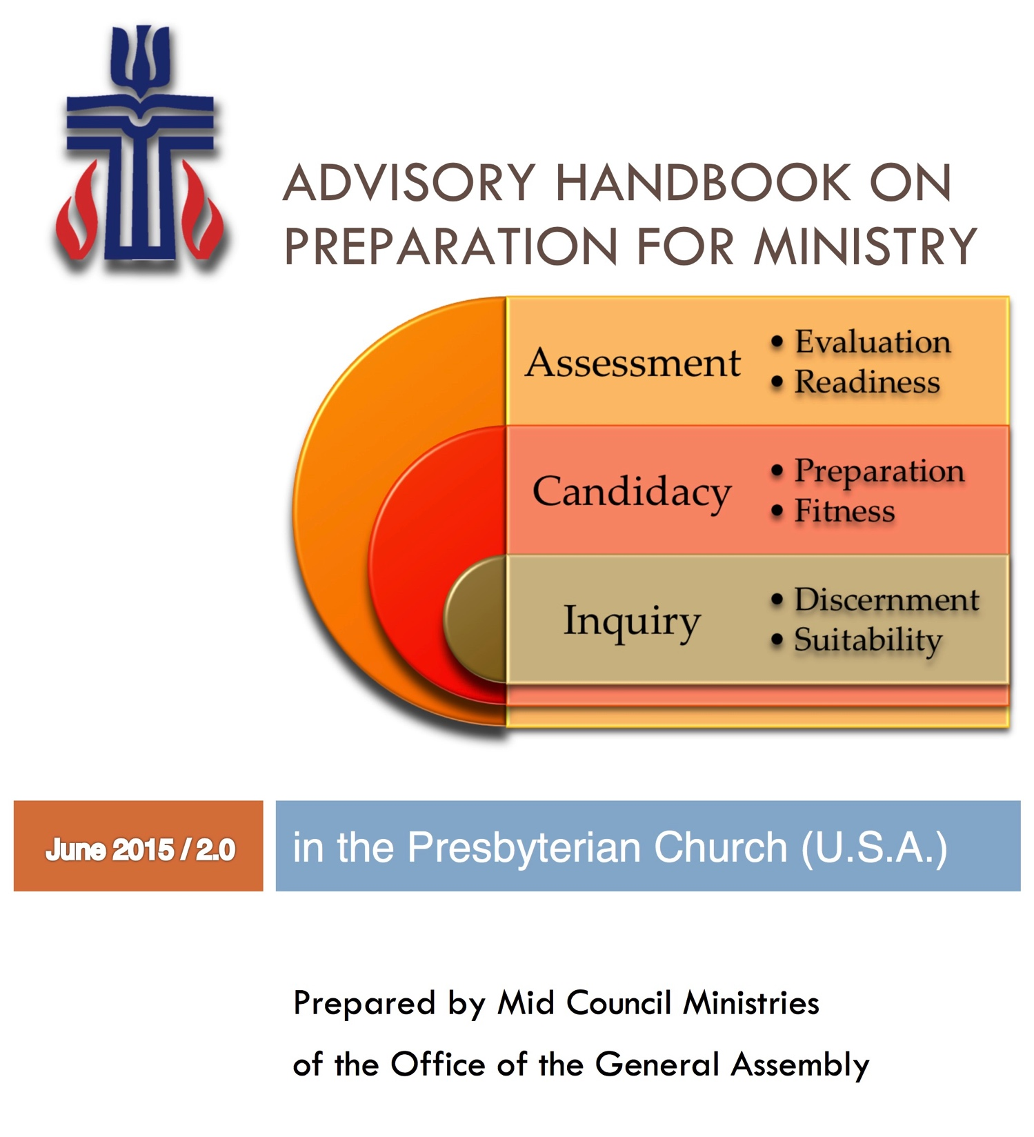

Slide 22
pcusa.org http://oga.pcusa.org/section/mid-council-ministries/prep4min/

